Slide 1
Graphics
Mostly the classes graphics category are in two packages
java.awt.*
javax.swing.*; [ All classes in this package starts with letter J]
Graphics Programming in Java is Component oriented.

Slide 2
Partial View of Graphics class Hierarchy
Object
Color
Graphics
Graphics2D
Component
Button
Convas
Checkbox
Container
JComponent
AbstractButton
Window
JPanel
JButton
Frame
GridBagLayout
JFrame
Panel
BorderLayout
Applet
FlowLayout
JApplet
BoxLayout
Layout managers for containers
GridLayout
CardLayout

Slide 3
JFrame in Java
  An actual Window having Title Bar, Menu Bar, Borders and resizing corners.
  Imporatant Constructors :
  JFrame()
  Constructs a new frame that is initially invisible.
  JFrame(String title)
  Creates a new, initially invisible Frame with the specified title.
  Important Methods :
  Container getContentPane()
  Returns the contentPane object for this frame.
  void setLayout(LayoutManager manager)
  Sets the LayoutManager.
  void setDefaultCloseOperation(int operation)
  void setSize(FRAME_WIDTH,FRAME_HEIGHT)
  void show(); -→ shows the frame Now Deprecated
  setVisible(true/false); // Actual Method Java 2 for displaying Frames.

Slide 4
JFrame Examples
JFrame f1 = new JFrame(); // Creates a Frame with no title
JFrame f2 = new JFrame(“My Frame”); // Frame with Title “MY Frame”
f1.setSize(400,600); // sets size to 400 by 600 pixels
f2.setDefaultCloseOperation(JFrame.EXIT_ON_CLOSE);
(Program Terminates when Frame Window is closed)
Adding Components to JFrame (Upto 1.4.2)
Conatiner c1 = f1.getContentPane();
c1.setLayout(……….);
c1.add(<Component>);
In Java 1.5 (No need to get ContentPane)
f1.add(<Component>);

Slide 5
JPanel class in Java
Is just like a Frame window without Borders and a Title.
Flat panel window acts a light weight container
Constructors
JPanel()
Creates a new JPanel with a double buffer and a flow layout.
JPanel(LayoutManager layout)
Create a new buffered JPanel with the specified layout manager

Slide 6
JLabel Objects in Java
  Display text or image or both in Java Graphics
  Constructors :
  JLabel()
  JLabel(Icon image)
  JLabel(String text)
  3. Important Methods :
  setIcon(Icon icon);
  setText(String text);
  setSize(width,height);
  setForeground(Color.red);

Slide 7
Java.awt.Color class
Every Component can set foreground and background colors.
1. public void setBackground(java.awt.Color c)
2. public void setForeground(java.awt.Color c)
Colors can be set by passing arguments as :
Color.red
Color.black
Color.green

Slide 8
Layout Managers
Arrangements of several components within a container is called layout.
Conatiner’s layout can be set by passing LayoutManager object to setLayout() method.
Some basic Layouts :
1. FlowLayout :
“Lays out components left to right and then starts from new row when there is not enough room in the current one.”
2. BOXLayout :
“ Lays out components horizontally or vertically”
3. BorderLayout :
This layout has five areas for laying out. NORTH,SOUTH,EAST,WEST and CENTER.

Slide 9
Layout Managers continued…
GridLayout :
“ Arraganges Components in a rectangular grid. All Components are resized to an identical size”.
GridBagLayout:
“ Also Arraganges Components in a grid but rows and columns can have different sizes andcomponents can span multiple rows and columns”.

Slide 10
JTextField class
A text field is a text component that displays editable text.
Standard mechanism for input into graphics program.
Constructors :
JTextField()
JTextField(String text)
JTextField(int columns)
JTextField(String text, int columns)

Slide 11
Icon Interface
Used to create and define icons.
public interface Icon
{
public int getIconHeight();
public int getIconWidth();
public void paintIcon(Component c, Graphics g, int x, int y)
}
Graphics Parameter carries out the Drawing operation.
To use more powerful 2D drawing operations we have to type case to Graphics2D

Slide 12
Icon interface ….
paintIcon method receives graphics context of type Graphics
Actually a Graphics2D object in modern Java versions
public void paintIcon(Component c, Graphics g, int x, int y)
{
Graphics2D g2 = (Graphics2D)g;
. . .
}

Slide 13
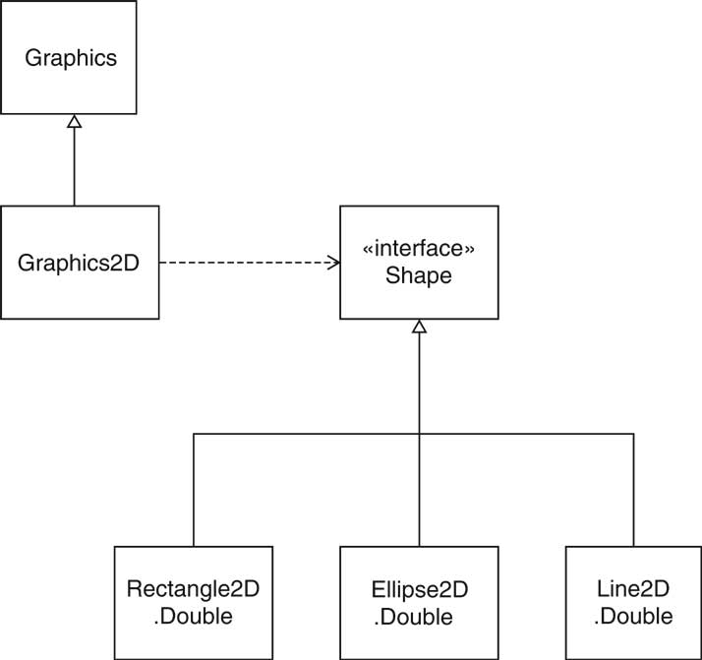
Drawing Shapes
We can draw objects of any class that implements shape interface

Slide 14
Drawing shapes ….
Shape s = …….
g2.draw(s);
Shape s = new Rectangle2D.Double(x,y,width,height);
g2.draw(s); // Rectangle will be drawn
Shape s = new Ellipse2D.Double(x,y,width,height);
g2.draw(s); // Ellipse will be drawn
Shape s = new Rectangle2D.Double(x,y,width,width);
g2.draw(s); // Circle will be drawn

Slide 15
Drawing shapes cont….
Point2D.Double start = new Point2D.Double(x1,y1);
Point2D.Double end = new Point2D.Double(x1,y1);
Shape s1 = new Line2D.Double(start,end);
g2.draw(s1);

Slide 16
Example 1 Circle Icon
class circleicon implements Icon
{
private int size; // radius
circleicon(int radius) { size = radius;}
public int getIconHeight() { return size;}
public int getIconWidth() { return size;}
public void paintIcon(Component c, Graphics g, int x,int y)
{
Graphics2D g2 = (Graphics2D) g;
Ellipse2D.Double circle = new Ellipse2D.Double(x,y,size,size);
g2.draw(circle);
}
}

Slide 17
Example 2 RectangleIcon
class recticon implements Icon
{
private int height;
private int width;
recticon(int height,int witdh)
{
this.height = height;
this.width = width;
}
public int getIconHeight() { return height;}
public int getIconWidth() { return width;}
public void paintIcon(Component c, Graphics g, int x,int y)
{
Graphics2D g2 = (Graphics2D) g;
Rectangle2D.Double r1 = new Rectangle2D.Double(5,5,x-width,y-height);
g2.draw(r1);
}
}

Slide 18
Example
RED
<< Hello How are You>>
GREEN
Hello
Hi

Slide 19
import java.awt.*;
import javax.swing.*;
class MainFrameTest
{
public static void main(String args[])
{
// Creating Frame Window with title Main Frame and setting size and layout
JFrame frame = new JFrame("Main Frame");
frame.setSize(400,600);
frame.setLayout(new BorderLayout());
// color button Panel
JPanel colorButtonPanel = new JPanel();
colorButtonPanel.setLayout(new BoxLayout(colorButtonPanel,BoxLayout.Y_AXIS));
// text button Panel
JPanel textButtonPanel = new JPanel();
// label display panel
JPanel labelDisplayPanel = new JPanel();
labelDisplayPanel.setLayout(new BorderLayout());

Slide 20
// label to be displayed
JLabel displayLabel =new JLabel("Hello How are you");
// Add displayLabel to labelDisplayPanel
labelDisplayPanel.add(displayLabel,BorderLayout.CENTER);
// Creating buttons
JButton red = new JButton("RED");
JButton green = new JButton("GREEN");
JButton hello = new JButton("Hello");
JButton hi = new JButton("Hi");
// Addings red and green buttons to color panel
colorButtonPanel.add(red);
colorButtonPanel.add(green);
// Adding text buttons to textButton Panels
textButtonPanel.add(hello);
textButtonPanel.add(hi);
// adding panels to frame
frame.add(labelDisplayPanel,BorderLayout.CENTER);
frame.add(colorButtonPanel,BorderLayout.EAST);
frame.add(textButtonPanel,BorderLayout.SOUTH);
// Displaying Frame
frame.setDefaultCloseOperation(JFrame.EXIT_ON_CLOSE);
frame.setVisible(true);
}// End of main() Method
}// End of class mainFrameTest

